Slide 1

Peugeot
EA Analysis
April 19th , 2012

Slide 2
Notes
Please view in Slide Show mode for better readability as text is in small font at some places
Please review the Slide Notes for additional data points where available
Sources: This document has been produced from publicly available resources. This is not intended to be a statement on any individual company’s strategy or a definitive statement of the industry challenges being faced.
Intended Use: This document is NOT intended as a detailed Industry backgrounder.
This information is to be used internally by Microsoft as a reference guide for industry data and information.

Slide 3
EA Analysis
EA Licenses Analysis

Slide 4
Licenses Summary (Enterprise6)
Active
Customer Name | Sales Location | Agree Type | Agreement | Program | Status | Agreement Start Date | Agreement End Date
Peugeot Motorcycles | France | Standard Enrollment | 2514735 | Enterprise 6 | Active | May 1 2006 | Apr 30 2009
Peugeot Motorcycles | France | Standard Enrollment | 8186623 | Enterprise 6 | Active | May 1 2009 | Apr 30 2012
There is only one Active EA enterprise 6 Agreement 8186623
Risk Rating 0-1 years – 1rating, 1-3 years 2 rating, 3-5 years 3 rating, 5-6 years 4 rating, 6 and above 5 rating

Slide 5
Licenses Summary (Enterprise 6) (1/2)
Expiring April 30 2012
Product Name | Number of Licenses | Version | Latest Version | Mainstream Support | Migration Lag | Risk Rating | Deployed Number of Licenses
Commerce Server 2009 | 2 | 2009 | 2009 R2 | 07-08-2014 | 1 | 2 | -
Exchange Server 2010 | 440 | 2010 | 2010 | 10-13-2015 | None | 2 | -
Expression Studio Web 4 | 4 | 4 | 4 | 10-11-2012 | None | 2 | -
Internet Security and Acceleration Server 2006 | 1 | 2006 | 2006 | 01-10-2012 | None | 1 | -
Office 2010 | 440 | 2010 | 2010 | 10-13-2015 | None | 2 | 3000
Project 2010 | 10 |  |  |  |  |  | -
SharePoint Server 2010 | 442 | 2007 | 2010 | 10-13-2015 | 1 | 2 | -
SQL Server 2008 R2 | 162 | 2010 | 2010 | 01-14-2014 | None | 2 | -
System Center Configuration Manager 2007 R2 | 440 | 2007 R2 | 2007 R3 | 07-08-2014 | 1 | 2 | -
Visio 2010 | 5 | 2010 | 2010 | 10-13-2015 | None | 2 | -
Visual Studio 2010 | 1 | 2010 | 2010 | 07-14-2015 | None | 2 | -
Windows Server 2008 R2 | 485 | 2008 R2 | 2008 R2 | 07-09-2013 | None | 2 | -
Risk Rating 0-1 years – 1rating, 1-3 years 2 rating, 3-5 years 3 rating, 5-6 years 4 rating, 6 and above 5 rating

Slide 6
Licenses Summary (Enterprise 6) 2/2
Expiring April 30 2012
Product Name | Number of Licenses | Version | Latest Version | Mainstream Support | Migration Lag | Risk Rating | Deployed Number of Licenses
Windows Vista | 440 | Vista | Win 7 | 04-10-2012 | 1 | 1 | 1000
Risk Rating 0-1 years – 1rating, 1-3 years 2 rating, 3-5 years 3 rating, 5-6 years 4 rating, 6 and above 5 rating

Slide 7
Solutions Mapping
Business solution map, IT Spending Analysis and Forecast for IT spend

Slide 8
IT Spending & Forecast: France
IT spending in the France Automotive industry is expected to grow at a CAGR of 3.1% from 2010-2015 with emphasis on the software development in the operations
France Automobile Industry IT Spend ( US $ Million)
France Automobile Industry IT Spend (US $ Million) by Categories, 2011
3.1%
Highlights
The automotive industry is recovering from the recession and is focusing its newfound enthusiasm for innovation on the connected car, mobile applications and electric vehicles.
The automotive companies are increasingly looking for innovation in the areas of vehicle-centric information and communication technologies (vehicle ICT), including the connected car, to create improved consumer experiences. As a result, automotive companies increasingly will need to partner with companies that have expertise in IT, Internet content or device design, such as content providers, Internet service providers and consumer electronics companies
The IT spend in the France automotive industry is foreseen to grow at a 3.1% CAGR over the period 20010-2015
In 2011, IT Services record the maximum contribution in the IT Spend of the France automotive industry
Source: Forecast: Enterprise IT Spending by Vertical Industry Market, Worldwide, 2009-2015, 2Q11 Update
Notes:
Notes:
*General Insurance pertains to Insurance other than health

Slide 9
IT Spending & Forecast: Peugeot
The IT spending in Peugeot is expected to grow at a CAGR of 7.1% from 2010-2015 with emphasis on IT Services
Peugeot IT Spend (US $ Million)
Peugeot IT Spend (US $ Million) by Categories, 2011
7.1%
Highlights
Peugeot posted an increase of 8% revenue gain in year 2011 when compared to 2010.
The IT spend in Peugeot is foreseen to grow at a 7.1% CAGR over the period 2010-2015
The IT spend in Peugeot for the year 2011 was US $ 2,363 million.
In 2011, IT Services record the maximum contribution in the IT Spend of the company
Source: Forecast: Enterprise IT Spending by Vertical Industry Market, Worldwide, 2009-2015, 2Q11 Update

Slide 10
CxO Discussion: Microsoft Opportunity and Solution Summary (Reference Architectures for Automotive)
Corporate Administration
Finance, Accounting, Human Resources, Royalties, Licensing
Channel Management
CRM
Business Intelligence Search Analytics
Partner Management
Customer Experience Management
CIS
Merchandising
Ad Management
Sales
Production and Planning
Marketing Metrics
Media Buying
Marketing
Budget Planning
Resource Management
Campaign Management
Rights Management
Contracts Management
Royalty Management
Content Life Cycle Management
Watermarking
DRM
Rights Acquisition
Distribution
Content Creation and Capture
Content Storage and Management
Content Monetization
Content Transfer, Transcoding, and Distribution
Asset Profitability
Workflow Management
Operations
(Varies by industry segment such as automation and scheduling systems, desktop publishing and editorial solutions)
Network Connectivity
WAN Acceleration
IP
Source: Gartner 2010
Source: Gartner 2010

Slide 11
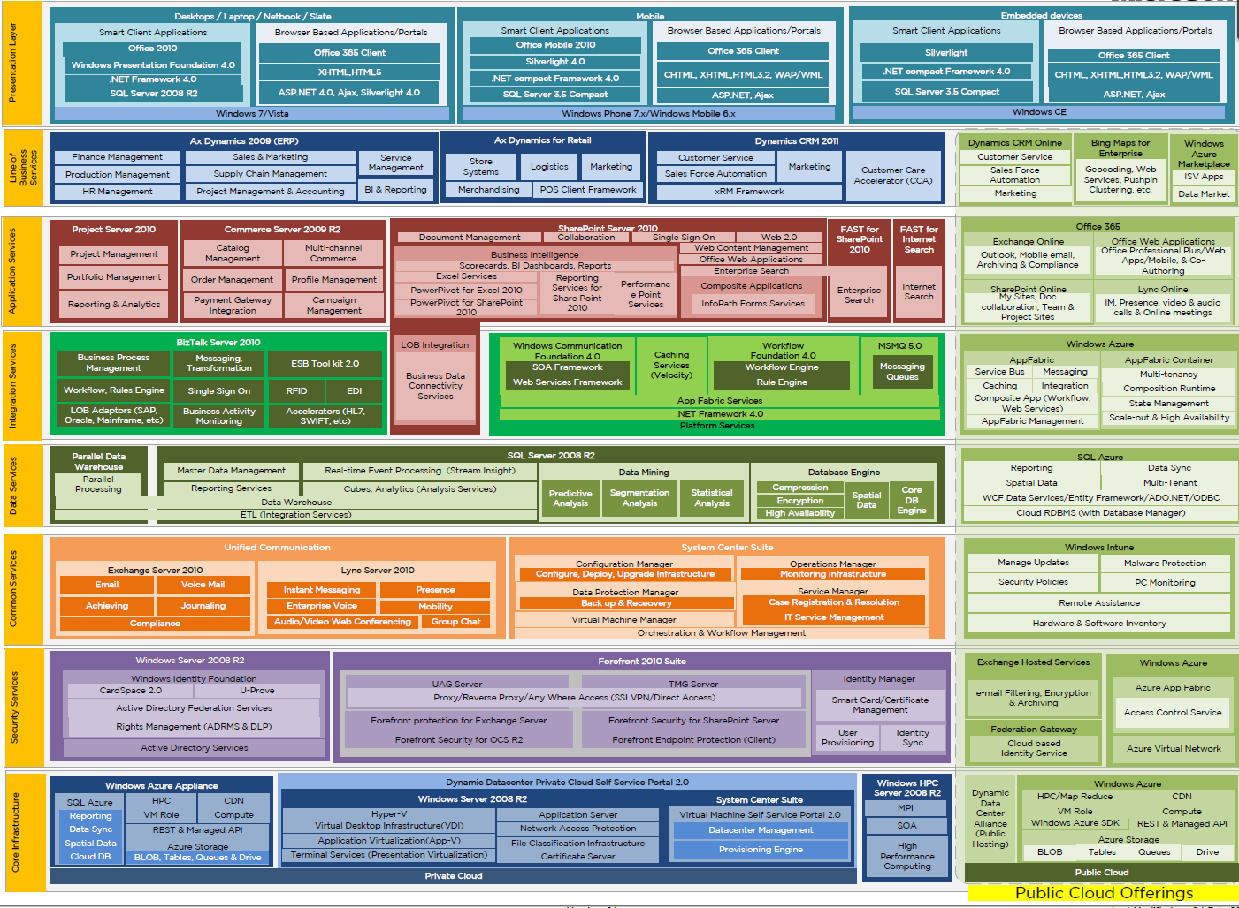
Enterprise Agreement
(July 2012)
New usage
At risk
New sale

